Slide 1
Transforming
Edge Computing
Microsoft Azure Local
Accelerated by Intel
A New Frontier for Microsoft Partners
Notes:
Transforming Edge Computing: Microsoft Azure Local Powered by Intel Technologies
This presentation aims to showcase Azure Local's role in revolutionizing Edge solutions, setting the stage for a comprehensive exploration of its benefits and applications for Microsoft Partners.
Microsoft Azure Local, powered by Intel, is a pivotal innovation in Edge computing, transforming data management and processing.
Azure Local brings a new level of hybrid flexibility and scalability to Edge computing, merging local high-performance computing with seamless cloud integration. By enabling real-time data processing and analytics at the Edge, it significantly reduces latency and enhances decision-making capabilities. Moreover, Azure Local's robust security features and its adaptability to diverse workloads make it an ideal solution for businesses looking to leverage the growing volumes of data generated at the Edge, ultimately driving efficiency and innovation in various industry sectors.
Edge computing has emerged as a critical technology in response to the exponential growth of data and the need for real-time processing. It decentralizes data processing, bringing computation closer to data sources, thereby enhancing efficiency and reducing latency in various applications.

Slide 2

Game-changing Security from Intel and Microsoft
Secure hardware, firmware and OS capabilities to help protect against threats
Intel® Supports Secured Core
Reduces the performance impact of pervasive encryption, making it possible for users to broadly encrypt data with minimal performance impact
Intel® Crypto Acceleration Technology
Encrypts memory holistically across the platform using hardware-generated keys, and encrypts VMs to help protect existing software
Intel® Total Memory Encryption and Total Memory Encryption Multi-Key
Fortify your infrastructure
Help protect data at Rest, in Transit, and in Use
Encrypt everything
Accelerating Cryptography and Data De/compression – supported in Microsoft SQL 2022 on Azure Local
Intel® Quick Assist Technology
Notes:
Key Takeaway: Hardware-assisted technology that provides security without compromising performance ensuring data is protected in memory, in transit, and at rest.
Security affects everyone in your organization from upper-level management to the information worker. Inadequate security is a real risk for organizations as a security breach can potentially disrupt all normal business and bring your organization to a halt. The sooner that you can detect a potential attack, the faster you can mitigate any compromise in security.
Azure Local provide out-of-the-box secure hardware proving you the trusted infrastructure ensuring your data is protected on-premises and in the cloud.
Built-in crypto accelerations provide security without the performance compromise.
When working across your hybrid cloud, whether it is on-premises or in the public cloud, Intel Trust Domain Extensions (TDX) is a Trusted Execution Environment (TEE) technology that works with Azure to provide confidential computing. TDX helps protect data by isolating virtual machines (VMs) from the host and hypervisor. This protects VMs from a variety of hardware and software attack. Additionally, if you are leveraging Azure Confidential Computing powered by Intel Xeon processors help with protecting at the application layer.

Slide 3
Why Run Workloads on 5th gen Intel® Xeon® Processors with Microsoft Azure Local?
Any Al Code, Every Workload
Build & Deploy Everywhere
Implement Pre-Built Solutions
A broad array of modern business applications are now being augmented with Al.
5th Gen Intel® Xeon® processors feature Intel® Advanced Matrix Extensions (Intel® AMX), which gives your Al-enabled apps the ability to deliver flexible and efficient performance.
Design and deploy Al projects quickly and efficiently with optimized training and inferencing.
Intel AMX brings extensive hardware and software optimizations to enable fast and efficient Al for a range of use cases, including video analytics, industrial machine vision, and natural language processing.
With the built-in Al accelerator, the result is an optimized pipeline on a single hardware and software platform that scales from data center to cloud to edge.
Customers can scale Al everywhere by leveraging the broad, open, optimized libraries, frameworks and pre-trained models available to speed deployment.
The flexibility of a standard 5th gen Intel® Xeon® processor server, with the efficiency and performance of a built-in AI accelerator
Notes:
Key Takeaway: Intel Xeon processors provide built-in acceleration for your most demanding workloads, such as AI
Azure Local running on Intel Xeon processors allows you to achieve a true hybrid cloud approach to seamlessly extend your datacenter to the public cloud providing you the freedom to compute. Processing your data closer to generation as well as leveraging the cloud to scale your processing for larger data sets. Together Azure Local and Intel deliver performance, scale and security to ensure you achieve your business goals efficiently.

Slide 4
Refresh and Consolidate: Use Fewer Servers
Save power and money on new server purchases, deploying fewer 5th Gen Intel Xeon processor-based servers to meet performance and TCO goals.
Comparisons to deploying 50 servers with 3rd Gen Intel® Xeon® processor
Web
(NGINX TLS)
Data Services
(RockDB)
Artificial Intelligence
(NLP w/Bert-Large)
Artificial Intelligence
(Recommender w/DLRM)
50 SERVERS
50 SERVERS
50 SERVERS
50 SERVERS
Number of
5th Gen Intel Xeon processor-based servers
29 SERVERS
14 SERVERS
13 SERVERS
10 SERVERS
Lower fleet energy
870 MWh
1,482 MWh
1644 MWh
1,705 MWh
TCO savings²
$442K³
$1,198K⁴
$1,273K⁵
$1,425K⁶
Performance varies by part, use, configuration and other factors. Learn more at
www.Intel.com/Performancelndex. See backup for workloads and configurations. Results may vary.
Notes:
Key Takeaway: Latest generation Intel Xeon processors provide benefits in power and cost savings
Latest generation Intel Xeon processors deliver more performance per core resulting in less servers needed to run the same workloads. If you currently have 50 servers running 3rd generation Intel Xeon processors, you can consolidate those workloads into 29 servers which reduces your datacenter footprint, power consumption AND lowers TCO. That’s close to ½ the systems needed today to run the same workloads. Together Azure Local and Intel can help reduce your footprint, improve your TCO, and accelerate your time to value within your business.
Do more, with less, achieve better results.

Slide 5
Meet Sustainability Goals: More Power Efficient
Modernizing infrastructure using Intel Xeon processors delivers TCO advantages that are even more substantial when replacing older equipment.
5 YEAR REFRESH
NEW SERVER DECISION
5th Gen vs.1st Gen
Intel® Xeon® Processors
5th Gen vs.1st Gen
Intel Xeon Processors
5th Gen vs. 3rd Gen
Intel Xeon Processors
5th Gen vs. 3rd Gen
Intel Xeon Processors
Web – NGINX TLS⁷
BERT-Large - AI - NLP¹
Data Services⁴
AI-Recommender⁶
UP TO
40%
TCO Savings²
UP TO
77%
TCO Savings²
UP TO
61%
TCO Savings²
UP TO
72%
TCO Savings²
REPLACE
REPLACE
BUY
BUY
50
50
14
5th Gen Xeon
10
1st Gen Xeon
1st Gen Xeon
5th Gen Xeon
WITH
7
WITH
3
VS.
50
50
5th Gen Xeon
5th Gen Xeon
3rd Gen Xeon
VS.
3rd Gen Xeon
~840 MWh
Fleet Energy Savings²
~1700 MWh
Fleet Energy Savings²
~1480 MWh
Fleet Energy Savings²
~1700 MWh
Fleet Energy Savings²
Performance varies by part, use, configuration and other factors. Learn more at
www.Intel.com/Performancelndex. See backup for workloads and configurations. Results may vary.
Notes:
Key Takeaway: When choosing a new server or looking to refresh older servers, latest generation Intel Xeon processors/ Azure Local based on latest generation Intel Xeon processors deliver the best performance per $ spent in a smaller footprint, reducing power and space requirements.
In this slide we provide 2 ways to look at why you want to use the latest generation Azure Local with Intel Xeon processors. The first is looking at 5 year old technology and refreshing. In this analysis, we share estimated power savings and consolidation that would occur from 50 servers to 7 last generation servers across 2 different workloads (Web services and AI).
The second is a new server purchase decision. If you are looking to procure new systems, this provides the analysis of why buy the latest generation of servers vs older technologies. Again, this demonstrates the consolidation and performance of workloads provide improvement in power and space savings ensuring you meet your sustainability goals.
Sustainability is important and datacenter space is limited. Using latest generation technology allows you to consolidate, achieve same or better performance, and reduce power and space requirements.

Slide 6
Microsoft Azure Local with 5th Gen Intel® Xeon® Processors Delivers Performance for Demanding Workloads
2.51
5th Gen Intel® Xeon® 8592+ (64C) vs AMD EPYC 9554 (64C)⁸
Higher is Better
2.17
EPYC9554
= 1.0
Web
Data Services
Storage
HPC
Performance increased gen-to-gen, scales with cluster size, and higher series of Xeon
Performance varies by part, use, configuration and other factors. Learn more at
www.Intel.com/Performancelndex. See backup for workloads and configurations. Results may vary.
Notes:
In the previous 2 slides we shared Intel generation to generation technology comparisons. We understand you have choices in your processor technology. In this slide, we compare 5th gen Intel Xeon to 5th gen AMD. To understand this chart, look at the red line. This is the baseline for AMD performance. We then compare against Intel performance – BLUE BAR, and Intel performance per watt – PURPLE BAR
Across workloads, 5th gen Intel Xeon processors exceed competitor performance and performance per watt.
Why is this important? This is to show that Azure Local on 5th gen Intel delivers the best performance and performance/watt to ensure that every $ you spend is supporting your business goals or sustainability and cost.

Slide 7
Microsoft Azure Local Powered by Intel Technologies
Your Key to Edge Computing
Brand
Breadth
Innovation
Fully integrated, certified solutions based on Microsoft and Intel
Secured core servers with Intel® Xeon® processors
Intel® Virtualization Technology, enhanced with each generation, enables more seamless migration between cloud environments.
Partner-friendly and partner-ready
Tested, integrated, and validated reference architectures
Multiple form factors (see Azure Local catalog)
OEM as a Service Offerings
APEX (Dell)
TruScale (Lenovo)
GreenLake (HPE)
Hybrid cloud architectures and implementations
Intel® Xeon® Processors with built-in accelerators
Seamless integration with Microsoft Azure and Azure Arc
Highly scalable with efficient resource usage and allocation
Robust hardware-based security without compromising performance
Notes:
Microsoft Azure Local Powered by Intel: Your Key to Edge Computing
The ‘magic gift’ that Microsoft/Intel brings to enable you to serve the Edge evolution ….

Slide 8
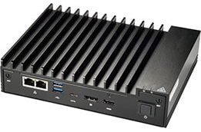
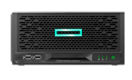
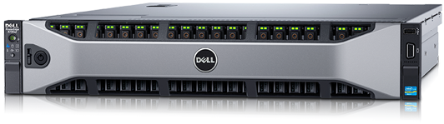
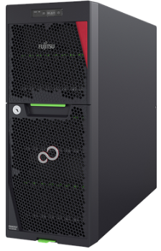
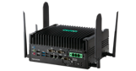
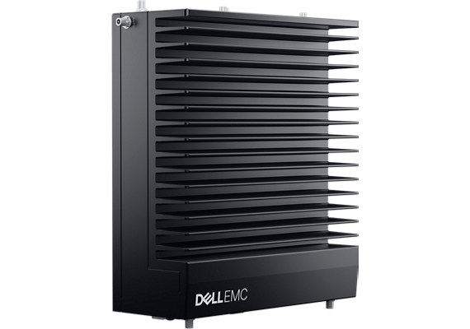
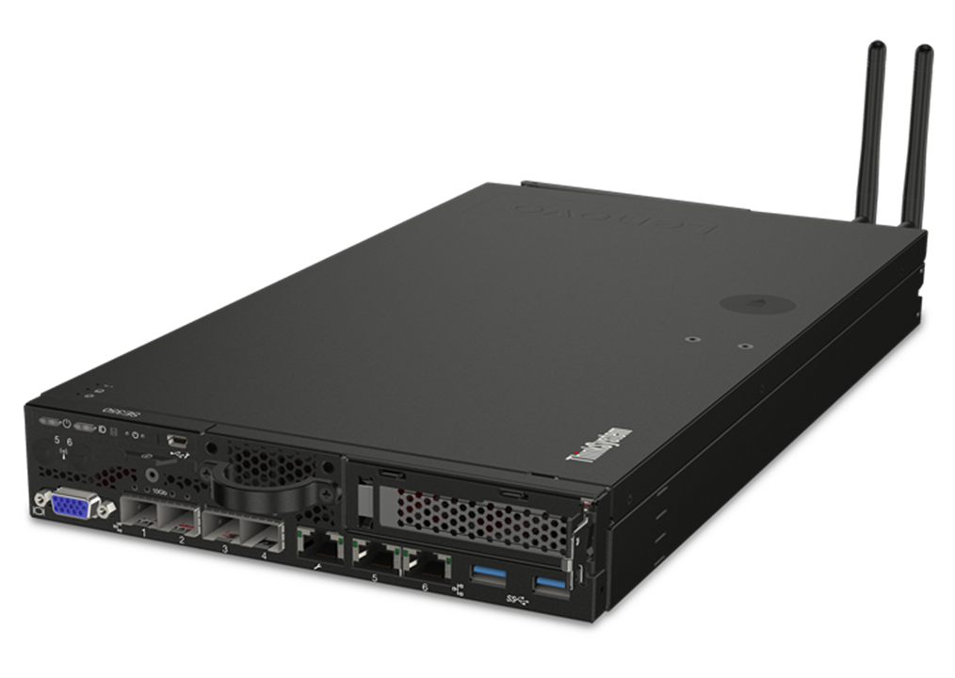
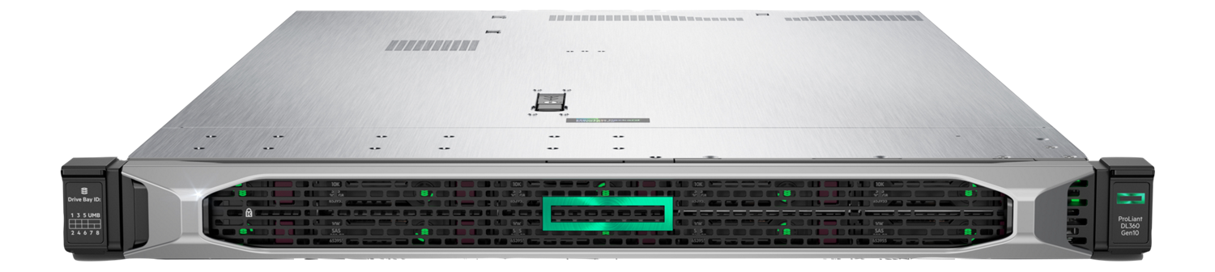
Informal Classification
Edge Hardware
Light edge
Medium edge
Heavy edge
~$1-3K/node
Desktop-like specs marketed at “IoT gateway” or “thin client”
~$2-5K/node
“Entry-level server” marketed at branch office and edge
~$8-20K/node
“Full-featured enterprise server” marketed at data center
SuperMicro E100-9S
Core i7, 4-32 GiB
DELL, HPE & Lenovo R/AX-750
2 x Xeon S, >3 TiB
HPE MicroServer
Xeon E, 4 core, 32 GiB
Fujitsu TX1330 M5
Xeon E, up to 128 GiB
HPE Edgeline EL300
Core i5/i7, 4-32 GiB
DELL, HPE & Lenovo
Core i3/i5/i7, 4-32 GiB
Lenovo SE350/MX1021
Xeon D, 4-16 core, up to 256 GiB
HPE ProLiant DL380
2 x Xeon S, >3 TiB
Typical differences (besides price)
Consumer vs server processor (e.g., Core i5 vs Xeon)
Error-correcting code memory (ECC)
Consumer vs enterprise SSDs (e.g., PLP)
Typical differences (besides price)
Form factor (rack mount vs not)
Single vs dual socket
Density, expandability, redundancy
Work with your category & OEM partners to ensure localization or to customize for your market – Refer to the Azure Local Catalog for the latest.
Notes:
Informal Classification; Edge Hardware

Slide 9
Thank you
THANK
YOU!
Notes:
Thank You!

Slide 10
Legal Disclaimers

Slide 11
Legal Text (1 of 4)
¹ Measurements on Natural language processing/BERT-Large; estimated over 4 years. See [T7] at intel.com/processorclaims: 5th Gen Intel Xeon Scalable processors. Results may vary.
² Estimated over four years.
³ See [T9] at intel.com/processorclaims : 5th Gen Intel Xeon Scalable processors. Results may vary.
⁴ See [T10] at intel.com/processorclaims : 5th Gen Intel Xeon Scalable processors. Results may vary.
⁵ See [T11] at intel.com/processorclaims : 5th Gen Intel Xeon Scalable processors. Results may vary.
⁶ See [T12] at intel.com/processorclaims : 5th Gen Intel Xeon Scalable processors. Results may vary.
⁷ See [T6] at intel.com/processorclaims : 5th Gen Intel Xeon Scalable processors. Results may vary.
⁸ 5th Gen Xeon Mainstream Workload Performance.
Server-Side Java SLA
Intel Xeon 8592+: 1-node, 2x INTEL(R) XEON(R) PLATINUM 8592+, 64 cores, HT on, Turbo on, Total memory 1024GB (16x64GB DDR5 5600 MT/s [5600 MT/s]), BIOS 3B05.TEL4P1, microcode 0x21000161, 2x Ethernet Controller X710 for 10GBASE-T, 1x 1.7T SAMSUNG MZQL21T9HCJR-00A07, Ubuntu 22.04.1 LTS, 5.15.0-78-generic, Server-side Java SLA throughput. Test by Intel as of 10/06/23.
AMD EPYC 9554: 1-node, 2x AMD EPYC 9554 64-Core Processor, 64 cores, HT on, Turbo on, Total memory 1536GB (24x64GB DDR5 4800 MT/s [4800 MT/s]), BIOS 1.5, microcode 0xa10113e, 2x Ethernet Controller 10G X550T, 1x 1.7T SAMSUNG MZ1L21T9HCLS-00A07, Ubuntu 22.04.3 LTS, 5.15.0-78-generic, Server-side Java SLA throughput. Test by Intel as of 10/24/23.
NGINX TLS
Intel Xeon 8592+: 1-node, 2x 5th Gen Intel Xeon Scalable processor (64 core) with integrated Intel Quick Assist Technology (Intel QAT), QAT device utilized=4(1 active socket), HT on, Turbo off, SNC on, with 1024GB DDR5 memory (16x64 GB 5600), microcode 0x21000161, Ubuntu 22.04.3 LTS, 5.15.0-78-generic, 1x 1.7T SAMSUNG MZWLJ1T9HBJR-00007, 1x Intel® Ethernet Network Adapter E810-2CQDA2, 1x100GbE, NGINX Async v0.5.1, OpenSSL 3.1.3, IPP Crypto 2021.8, IPsec MB v 1.4, QAT_Engine v 1.4.0, QAT Driver 20.l.1.1..20-00030, TLS 1.3 Webserver: ECDHE-X25519-RSA2K, tested by Intel October 2023.
AMD EPYC 9554: 1-node, AMD platform with 2x 4th Gen AMD EPYC processor (64 cores), SMT on, Core Performance Boost off, NPS1, Total memory 1536GB (24x64GB DDR5-4800), microcode 0xa10113e, Ubuntu 22.04.3 LTS, 5.15.0-78-generic, 1x 1.7T SAMSUNG MZWLJ1T9HBJR-00007, 1x Intel® Ethernet Network Adapter E810-2CQDA2, 1x100GbE, NGINX Async v0.5.1, OpenSSL 3.1.3, TLS 1.3 Webserver: ECDHE-X25519-RSA2K, tested by Intel October 2023.

Slide 12
Legal Text (2 of 4)
ClickHouse
Intel Xeon 8592+: 1-node, 2x 5th Gen Intel Xeon Scalable processor 8592+ (64 cores) with integrated Intel In-Memory Analytics Accelerator (Intel IAA), Number of IAA device utilized=4 (1 sockets active), HT on, Turbo on, SNC off, Total memory 1024GB (16x64GB DDR5-5600), microcode 0x21000161, 2x Ethernet Controller 10-Gigabit X540-AT2, 1x 1.7T SAMSUNG MZQL21T9HCJR-00A07, Ubuntu 22.04.3 LTS, 6.5.0-060500-generic, ZSTD v1.5.0, QPL v1.3dev, accel-config-v4.1.1, clang13, Clickhouse 21dev, Star Schema Benchmark, Query 4.1, tested by Intel October 2023.
AMD EPYC 9554: 1-node, AMD platform with 2x 4th Gen AMD EPYC processor (64 cores), SMT on, Core Performance Boost on, NPS1, Total memory 1024GB (16x64GB DDR5-4800), microcode 0xa10113e, 2x Ethernet Controller 10G X550T, 1x 1.7T SAMSUNG MZQL21T9HCJR-00A07, Ubuntu 22.04.3 LTS, 6.5.0-060500-generic, ZSTD v1.5.0, clang13, Clickhouse 21dev, Star Schema Benchmark, Query 4.1, tested by Intel October 2023.
RocksDB
Intel Xeon 8592+: 1-node, 2x 5th Gen Intel Xeon Scalable processor 8592+ (64 cores) with integrated Intel In-Memory Analytics Accelerator (Intel IAA), Number of IAA device utilized=8(2 sockets active), HT on, Turbo on, SNC off, Total memory 1024GB (16x64GB DDR5-5600), microcode 0x21000161, 2x Ethernet Controller 10-Gigabit X540-AT2, 1x 1.7T SAMSUNG MZQL21T9HCJR-00A07, Ubuntu 22.04.3 LTS, 6.5.0-060500-generic, QPL v1.2.0, accel-config-v4.0, iaa_compressor plugin v0.3.0, ZSTD v1.5.5, gcc 10.4.0, RocksDB v8.3.0 trunk (commit 62fc15f) (db_bench), 4 threads per instance, 64 RocksDB instances, tested by Intel October 2023.
AMD EPYC 9554: 1-node, AMD platform with 2x 4th Gen AMD EPYC processor (64 cores), SMT on, Core Performance Boost on, NPS1, Total memory 1024GB (16x64GB DDR5-4800), microcode 0xa10113e, 2x Ethernet Controller 10G X550T, 1x 1.7T SAMSUNG MZQL21T9HCJR-00A07, Ubuntu 22.04.3 LTS, 6.5.0-060500-generic, ZSTD v1.5.5, gcc 10.4.0, RocksDB v8.3.0 trunk (commit 62fc15f) (db_bench), 4 threads per instance, 28 RocksDB instances, tested by Intel October 2023.
HammerDB MySQL
Intel Xeon 8592+: 1-node, 2x Intel Xeon Platinum 8592+, 64 cores, HT on, Turbo on, NUMA 2, Integrated Accelerators Available [used]: DLB 8 [0], DSA 8 [0], IAX 8 [0], QAT 8 [0], Total memory 1024GB (16x64GB DDR5 5600 MT/s [5600 MT/s]), BIOS 2.0, microcode 0x21000161, 2x Ethernet Controller X710 for 10GBASE-T, 1x 1.7T SAMSUNG MZQL21T9HCJR-00A07, 2x 1.7T SAMSUNG MZWLJ1T9HBJR-00007, Ubuntu 22.04.3 LTS, 5.15.0-84-generic, HammerDB Mv4.4, MySQL 8.0.33. Test by Intel as of 10/04/23.
AMD EPYC 9554: 1-node, 2x AMD EPYC 9554 64-Core Processor, 64 cores, HT on, Turbo on, NUMA 2, Integrated Accelerators Available [used]: DLB 0 [0], DSA 0 [0], IAX 0 [0], QAT 0 [0], Total memory 1536GB (24x64GB DDR5 4800 MT/s [4800 MT/s]), BIOS 1.5, microcode 0xa10113e, 2x Ethernet Controller X710 for 10GBASE-T, 1x 1.7T SAMSUNG MZQL21T9HCJR-00A07, 2x 1.7T SAMSUNG MZWLJ1T9HBJR-00007, Ubuntu 22.04.3 LTS, 5.15.125-0515125-generic, HammerDB v4.4, MySQL 8.0.33. Test by Intel as of 10/05/23.
HammerDB Microsoft SQL Server + Backup
Intel Xeon 8592+: 1-node, 2x 5th Gen Intel Xeon Scalable processor 8592+ (64 cores) with integrated Intel Quick Assist Technology (Intel QAT), Number of IAA device utilized=8(2 sockets active), HT on, Turbo on, SNC off, Total memory 1024GB (16x64GB DDR5-5600), microcode 0x21000161, 2x Ethernet Controller 10-Gigabit X540-AT2, 7x 3.5T INTEL SSDPE2KE032T807, QATZip 2.0.W.1.9.0-0008, Microsoft Windows Server Datacenter 2022, Microsoft SQL Server 2022, SQL Server Management Studio 19.0.1, HammerDB 4.5, tested by Intel October 2023.
AMD EPYC 9554: 1-node, AMD platform with 2x 4th Gen AMD EPYC processor (64 cores), SMT on, Core Performance Boost on, NPS1, Total memory 1536GB (24x64GB DDR5-4800), microcode 0xa10113e, 2x Ethernet Controller 10G X550T, 7x 3.5T INTEL SSDPE2KE032T807, Microsoft Windows Server Datacenter 2022, Microsoft SQL Server 2022, SQL Server Management Studio 19.0.1, HammerDB 4.5, tested by Intel October 2023.

Slide 13
Legal Text (3 of 4)
SPDK 128K QD64 (large media files) / SPDK 16K QD256 (database requests)
Intel Xeon 8592+: 1-node, 2x 5th Gen Intel Xeon Scalable processor (64 core) with integrated Intel Data Streaming Accelerator (Intel DSA), DSA device utilized=1(1 active socket), HT on, Turbo on, SNC off, with 1024GB DDR5 memory (16x64 GB 5600), microcode 0x21000161, Ubuntu 22.04.3 LTS, 5.15.0-78-generic, 1x 894.3G Micron 7450, 4x 3.84TB Samsung PM1733, 1x Intel® Ethernet Network Adapter E810-2CQDA2, 2x100GbE, FIO v3.34, SPDK 22.05, tested by Intel October 2023.
AMD EPYC 9554: 1-node, AMD platform with 2x 4th Gen AMD EPYC processor (64 cores), SMT on, Core Performance Boost on, NPS2, Total memory 1536GB (24x64GB DDR5-4800), microcode 0xa10113e, Ubuntu 22.04.3 LTS, 5.15.0-78-generic, 1x 1.7T Samsung PM9A3, 4x 3.84TB Samsung PM1733, 1x Intel® Ethernet Network Adapter E810-2CQDA2, 2x100GbE, 1x Ethernet Connection X550T for 10GBASE-T, FIO v3.34, SPDK 22.05, tested by Intel October 2023.
LINPACK
Intel Xeon 8592+: 1-node 2x Intel Xeon 8592+, HT on, Turbo on, SNC2, 1024 GB DDR5-5600, ucode 0x21000161, Red Hat Enterprise Linux 8.7, 4.18.0-425.10.1.el8_7.x86_64, HPL from MKL_v2022.1.0, cmkl:2023.2.0, icc:2023.2.0, impi:2021.10.0. Test by Intel as of October 2023.
AMD EPYC 9554: 1-node, 2x AMD EPYC 9554, SMT on, Turbo on, CTDP=360W, NPS=4, 1536GB DDR5-4800, ucode=0xa101111, Red Hat Enterprise Linux 8.7, Kernel 4.18, AMD official binary. Test by Intel as of March 2023.
NAMD (Geomean of apoa1_npt_2fs, stmv_npt_2fs)
Intel Xeon 8592+: 1-node 2x Intel Xeon 8592+, HT on, Turbo on, SNC2, 1024 GB DDR5-5600, ucode 0x21000161, Red Hat Enterprise Linux 8.7, 4.18.0-425.10.1.el8_7.x86_64, NAMD v2.15alpha, cmkl:2023.2.0 icc:2023.2.0 tbb:2021.10.0. Test by Intel as of October 2023.
AMD EPYC 9554: 1-node, 2x AMD EPYC 9554, SMT on, Turbo on, CTDP=360W, NPS=4, 1536GB DDR5-4800, ucode=0xa101111, Red Hat Enterprise Linux 8.7, Kernel 4.18, NAMD v2.15alpha, cmkl:2023.2.0 icc:2023.2.0 tbb:2021.10.0.
LAMMPS (Geomean of Polyethylene,DPD,Copper, Liquid Crystal,Atomic Fluid,Protein, Stillinger-Weber,Tersoff, Water)
Intel Xeon 8592+: 1-node 2x Intel Xeon 8592+, HT on, Turbo on, SNC2, 1024 GB DDR5-5600, ucode 0x21000161, Red Hat Enterprise Linux 8.7, 4.18.0-425.10.1.el8_7.x86_64, LAMMPS v2021-09-29, cmkl:2023.2.0 icc:2023.2.0 tbb:2021.10.0, impi:2021.10.0. Test by Intel as of October 2023.
AMD EPYC 9554: 1-node, 2x AMD EPYC 9554, SMT on, Turbo on, CTDP=360W, NPS=4, 1536GB DDR5-4800, ucode= 0xa101111, Red Hat Enterprise Linux 8.7, Kernel 4.18, LAMMPS v2021-09-29, cmkl:2023.2.0 icc:2023.2.0 tbb:2021.10.0, impi:2021.10.0. Test by Intel as of March 2023.

Slide 14
Legal Text (4 of 4)
FSI KERNELS (GEOMEAN OF BINOMIAL OPTIONS, MONTE CARLO, BLACKSCHOLES)
Binomial Options
Intel Xeon 8592+: 1-node 2x Intel Xeon 8592+, HT on, Turbo on, SNC2, 1024 GB DDR5-5600, ucode 0x21000161, Red Hat Enterprise Linux 8.7, 4.18.0-425.10.1.el8_7.x86_64, Binomial Options v1.1, icc:2023.2.0 tbb:2021.10.0. Test by Intel as of October 2023.
AMD EPYC 9554: 1-node, 2x AMD EPYC 9554, SMT on, Turbo on, CTDP=360W, NPS=4, 1536GB DDR5-4800, ucode=0xa101111, Red Hat Enterprise Linux 8.7, Kernel 4.18, Binomial Options v1.1, icc:2023.2.0 tbb:2021.10.0. Test by Intel as of March 2023.
Monte Carlo
Intel Xeon 8592+: 1-node 2x Intel Xeon 8592+, HT on, Turbo on, SNC2, 1024 GB DDR5-5600, ucode 0x21000161, Red Hat Enterprise Linux 8.7, 4.18.0-425.10.1.el8_7.x86_64, Monte Carlo v1.2, cmkl:2023.2.0 icc:2023.2.0 tbb:2021.10.0. Test by Intel as of October 2023.
AMD EPYC 9554: 1-node, 2x AMD EPYC 9554, SMT on, Turbo on, CTDP=360W, NPS=4, 1536GB DDR5-4800, ucode=0xa101111, Red Hat Enterprise Linux 8.7, Kernel 4.18, Monte Carlo v1.2, cmkl:2023.2.0 icc:2023.2.0 tbb:2021.10.0. Test by Intel as of March 2023.
Black-Scholes
Intel Xeon 8592+: 1-node 2x Intel Xeon 8592+, HT on, Turbo on, SNC2, 1024 GB DDR5-5600, ucode 0x21000161, Red Hat Enterprise Linux 8.7, 4.18.0-425.10.1.el8_7.x86_64, Black Scholes v1.4, cmkl:2023.2.0 icc:2023.2.0 tbb:2021.10.0. Test by Intel as of October 2023.
AMD EPYC 9554: 1-node, 2x AMD EPYC 9554, SMT on, Turbo on, CTDP=360W, NPS=4, 1536GB DDR5-4800, ucode=0xa101111, Red Hat Enterprise Linux 8.7, Kernel 4.18, Black Scholes v1.4, cmkl:2023.2.0 icc:2023.2.0 tbb:2021.10.0. Test by Intel as of March 2023.
⁹ See [T203] at intel.com/processorclaims: 5th Gen Intel Xeon Scalable processors. Results may vary.
¹⁰ See [T202] at intel.com/processorclaims : 5th Gen Intel Xeon Scalable processors. Results may vary.
¹¹ See [T201] at intel.com/processorclaims : 5th Gen Intel Xeon Scalable processors. Results may vary.
¹² See [T204] at intel.com/processorclaims : 5th Gen Intel Xeon Scalable processors. Results may vary.
¹³ See [T206] at intel.com/processorclaims : 5th Gen Intel Xeon Scalable processors. Results may vary.
¹⁴ Global Development Survey conducted by Evans Data Corp., 2021.
¹⁵ https://www.intel.com/content/www/us/en/newsroom/news/4th-gen-intel-xeon-momentum-grows-in-cloud.html#gs.4hpul6.
Performance varies by use, configuration and other factors. Learn more on the Performance Index site.
Performance results are based on testing as of dates shown in configurations and may not reflect all publicly available updates. See backup for configuration details. No product or component can be absolutely secure.
Your costs and results may vary. Intel does not control or audit third-party data. You should consult other sources to evaluate accuracy. Intel technologies may require enabled hardware, software or service activation.
© Intel Corporation. Intel, the Intel logo and other Intel marks are trademarks of Intel Corporation or its subsidiaries. Other names and brands may be claimed as the property of others.
0324/MH/MESH

