Slide 1
AMD AZURE LOCAL solutions
February 2025

Slide 2
AMD EPYC™ Processors
Business Value
Proven solutions
Seamless innovation
4000 Series
7000 Series
8000 Series
9000 Series
Practical
Fleet sustaining
Intelligent Edge
Performance and Ai Optimized
4th Gen
3rd Gen / 2nd Gen
4th Gen
5th Gen / 4th Gen
Attractively priced solutions for growing businesses and hosting services
Proven, cost effective DDR4 / PCIe® Gen4 technology delivering excellent performance
Energy efficient solutions optimized for the Edge, Telco, Retail and Healthcare
Optimized performance for the most demanding AI-enabled data center workloads
A complete portfolio of widely-deployed, optimized solutions, trusted by industry leaders
AMD EPYC™ CPUs integrated into Azure Local offerings
Notes:
AMD EPYC delivers a full portfolio of compute solutions delivering leadership performance and energy efficiency for a broad range of workloads and customer use cases – from our highly performant entry level 4000 series servers, our highly energy efficient 8000 series designed for the intelligent edge and Telco, to our highly scalable, performance leadership 9000 series.

Slide 3








Azure Local AMD Offerings
Latest Azure Local offering found here
* There’s a newer solution available

Slide 4
AMD SEV
Secure Encrypted Virtualization (SEV)
  Memory encryption (confidentiality) – Prevent hypervisor snooping of guest memory
  1st Generation AMD EPYCTM Processors (2017)
Secure Encrypted Virtualization with Encrypted State (SEV-ES)
  Register confidentiality – Protect guest registers across world switch
  1st Generation AMD EPYCTM Processors (2017)
Secure Encrypted Virtualization with Secure Nested Paging (SEV-SNP)
  Integrity protection for memory – Prevent hypervisor tampering of guest memory
  3rd Generation AMD EPYCTM Processors (2021)
  Guest support in Linux 5.19
  Host support expected to be merged in Linux 6.9
1st Gen EPYC (Naples)
2nd Gen EPYC (Rome)
3rd Gen EPYC (Milan)
SEV and SEV-ES
SEV and SEV-ES
SEV/SEV-ES/SEV-SNP
Up to 15 encrypted VMs
Up to 509 encrypted VMs
Up to 509 encrypted VMs
4th Gen EPYC (Genoa)
SEV/SEV-ES/SEV-SNP
Up to 1006 encrypted VMs

Slide 5
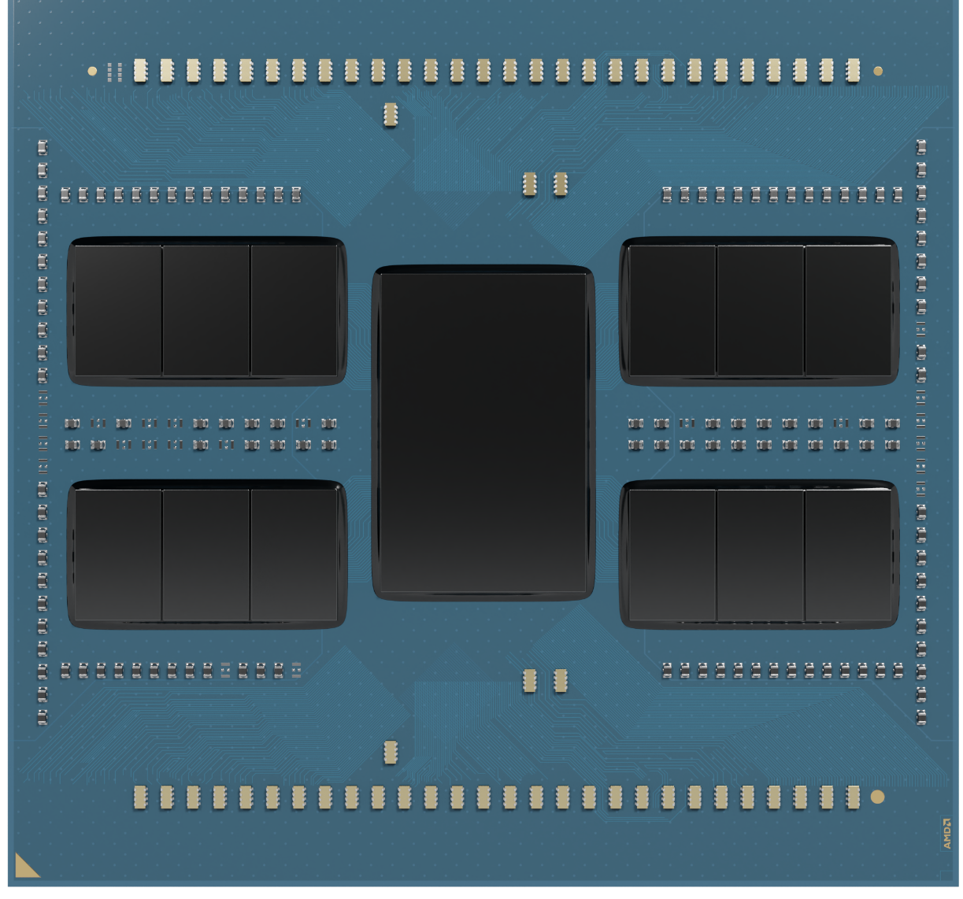
4th Gen AMD EPYC™ Processors
AMD EPYC™ 9004 Series – formerly codenamed “Genoa”
Advancing Data Center Performance and Efficiency
High
Performance
Cores
High Memory Bandwidth and Capacity
AMD
Infinity Guard
5nm Process Node
Energy Efficient
AMD Infinity Guard features vary by EPYC™ Processor series and/or generations. Infinity Guard security features must be enabled by server OEMs and/or Cloud Service Providers to operate. Check with your OEM or provider to confirm support of these features. Learn more about Infinity Guard at https://www.amd.com/en/technologies/infinity-guard. GD-183A
Notes:
Even with 4th Gen EPYC, we maintain leadership performance against the competition on several key benchmarks and workloads

Slide 6
4th Gen AMD EPYC™ CPUs
^{up to} 2.25x the performance of 5th Gen Intel® Xeon® CPUs
8592+ 64C
9754 128C
8592+ 64C
9684X 96C
8592+ 64C
9754 128C
9654 96C
8592+ 64C
9754 128C
8592+ 64C
9684X 96C
8592+ 64C
8592+ 64C
9684X 96C
As of 1/4/2024. See endnotes SP5-011F, 012E, 056C, 064C, 104B, 175A, 235
Notes:
The EPYC 4th generation processors still easily outperform Intel’s 5th generation top-of-stack processor 8592+ by an average of 67% across this set of workloads, and with better efficiency.
Benchmarks 4th Gen Xeon 5th Gen Xeon 4th Gen EPYC EPYC vs. 5th Gen
SPECrate®2017_fp_base 1040 1240 1630 1.31
SPECompG®_base2012 61.3 62.0 91.6 1.48
SAP® SD 2-tier 78387 96740 148000 1.53
SPECjbb®2015-MultiJVM critical-jOPS 368979 393776 679119 1.72
SPECrate®2017_int_base 1030 1130 1950 1.73
SPECjbb®2015-MultiJVM max-jOPS 505379 558626 988621 1.77
SPECpower_ssj®2008 17415 16106 36210 2.25

Slide 7
Performance leadership for technical computing
CFD and FEA | 32-Core Comparison
~1.8x
avg.
~1.8x
avg.
~1.5x
avg.
4th Gen Intel® Xeon®
8462Y+ 32 Core
4th Gen AMD EPYC™
9384X 32 Core
Sources: Chart shows maximum scores on benchmark subtests indicated. Average is across all subtests.
ANSYS CFX https://www.amd.com/system/files/documents/amd-epyc-9004x-pb-ansys-cfx.pdf ,
ANSYS LS-DYNA https://www.amd.com/system/files/documents/amd-epyc-9004x-pb-ansys-ls-dyna.pdf ,
ANSYS Fluent https://www.amd.com/system/files/documents/amd-epyc-9004x-pb-ansys-fluent.pdf,
OpenFOAM https://www.amd.com/system/files/documents/amd-epyc-9004x-pb-openfoam.pdf.
Notes:
Note that this is “apples to apples” using 32 core parts for both AMD and Intel. The increased L3 cache on the “X” parts deliver massive performance gains on “Technical Compute” workloads

Slide 8
Cloud native leadership
2.6x
Up to
the performance
4th Gen
Intel® Xeon® Platinum
8490H
4th Gen
AMD EPYC™
9754
Source: https://www.amd.com/content/dam/amd/en/documents/epyc-business-docs/performance-briefs/amd-epyc-9754-pb-cloud-native-workloads.pdf
Notes:
AMD EPYC 97x4 series deliver absolute leadership for real world cloud native deployments – with up to 2.6 times the performance vs Intel

Slide 9
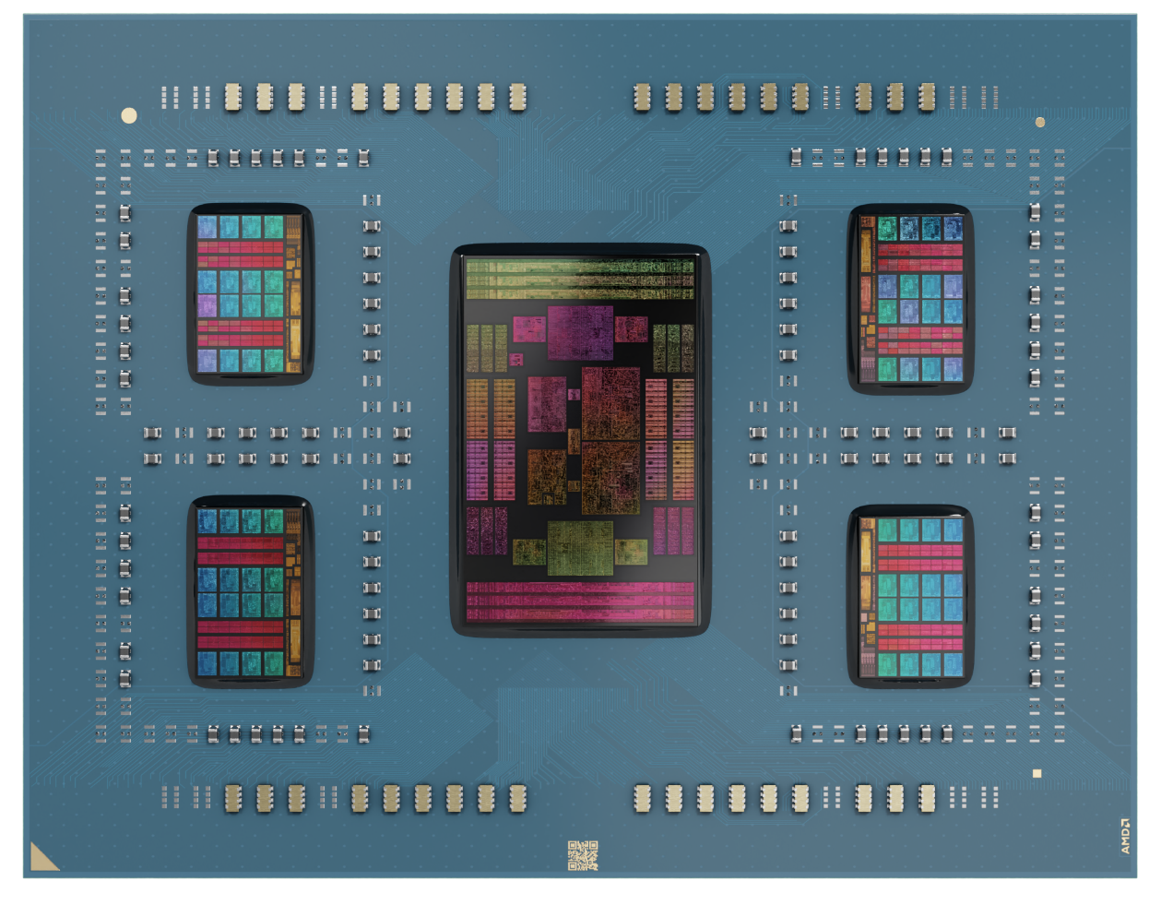
4th Gen AMD EPYC™ Processors
AMD EPYC™ 8004 Series – Formerly known as “Siena”
for Cloud Service, Intelligent Edge & Telco Deployments
Purpose-built, energy-efficient CPUs
Leadership
Performance per Watt/$
Thermally Optimized Processors
Excellent
Energy Efficiency
Balanced Performance
System Design Flexibility
Notes:
When we start building the product, we start with our customer in mind.
Siena is purpose-built to serve the diverse set of workloads & deployment requirements from Cloud to Edge.
It delivers excellent energy efficiency from high tech CSP rack-level installation to intelligent edge use cases.
With its proven architecture & built-in security capabilities it provides the performance required for a wide set of workloads.
The thermally & physically optimized SKU stack provides OEMs the system development simplicity.
It also gives end users the deployment flexibility in the most demanding operating conditions.
Siena does all this while offering leadership performance/W/$ enabling customers to reduce OPEX

Slide 10
4th Gen AMD EPYC 8004 Series Processors
Leadership Edge IoT Gateway Performance
^{Up to}1.9x the System Performance/Watt/System $*
Apache IoTDB points/second
(Higher is Better)
*System power in watts and system $ are estimated
Power = Power Determinism mode in BIOS. As of 9/18/2023, see endnote SP6-005.
Apache IotDB is a time series database, and this benchmark is facilitated using the IoT Benchmark
Notes:
Intel 4th generation 8 core vs AMD EPYC 8024P 8 core processors. AMD delivers almost 2X the performance per watt per dollar on Intelligent Edge workloads

Slide 11
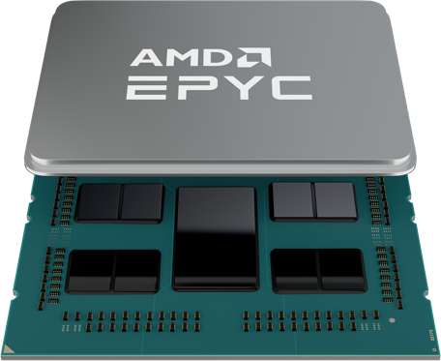

3rd Gen AMD EPYC™ Processors
AMD EPYC™ 7003 Series – Formerly known as “Milan”
Proven technology
Excellent price-performance
Compelling system value
Powerful and efficient
“Zen 3” cores
Advanced security features with
AMD Infinity Guard
Proven DDR4 and PCIe® Gen 4 technologies
Outstanding performance at a low system cost
Availability through 2026
AMD Infinity Guard features vary by EPYC™ Processor series and/or generations. Infinity Guard security features must be enabled by server OEMs and/or Cloud Service Providers to operate. Check with your OEM or provider to confirm support of these features. Learn more about Infinity Guard at https://www.amd.com/en/technologies/infinity-guard. GD-183A
Notes:
Many customers are not ready to move to the latest generation technologies (DDR5, PCIe Gen5) due to either not having time/resources to qualify them or because the cost premium remains too high to make the transition. AMD 3rd Gen processors offer a tremendous solution to those customers – allowing them to make the transition on their terms – when they are ready – while continue to offer outstanding performance and power savings – beating the performance of the competitions 4th Gen offerings in many cases

Slide 12
3rd Gen AMD EPYC™ Processors
Better Performance* per Est. System Price
Up
to
89%
Better
Perf/Est. Sys $
vs 4th Gen Intel
14%
Better
Perf/Est. Sys $
vs 4th Gen Intel
Up
to
8%
Better
Perf/Est. Sys $
vs 4th Gen Intel
Up
to
8 Cores Total
16 Cores Total
24 Cores Total
3rd Gen Intel® Xeon® “Ice Lake”
4th Gen Intel® Xeon® “Sapphire Rapids”
3rd Gen AMD EPYC™ “Milan”
* SPECrate®2017_int_base, Data normalized to Intel 4th Gen Xeon
Based on Endnotes: MLN-201, 202, 207,208,209,210
Notes:
AMD 3rd Gen offerings across 8, 16 and 24 products offers better price performance that competitions 3rd Gen and their latest 4th Gen offerings

Slide 13
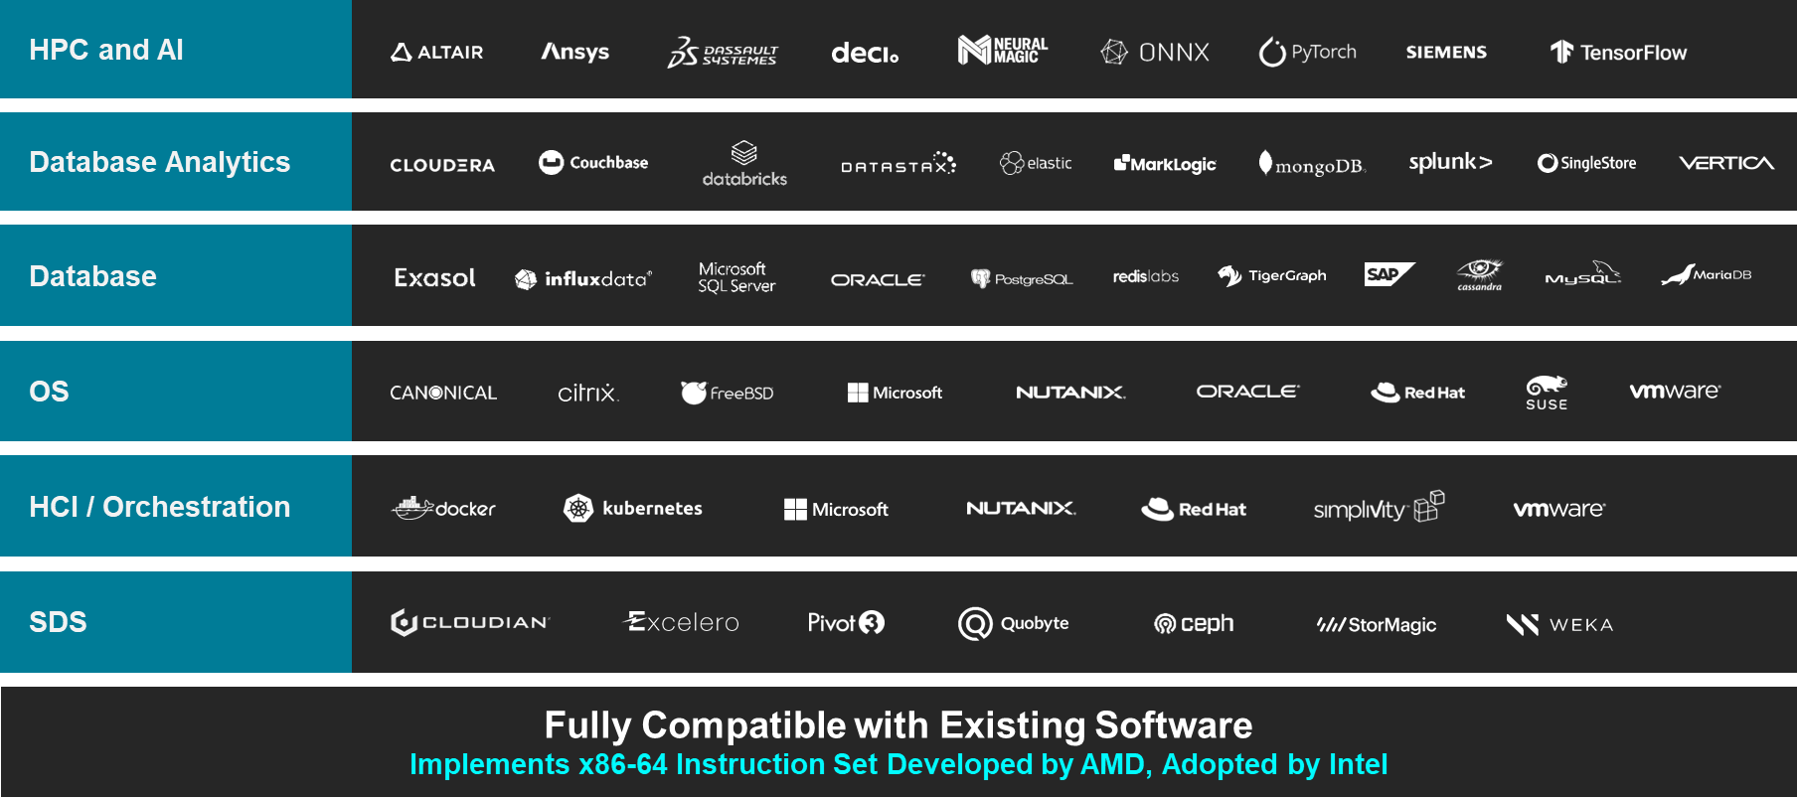

Zen Software Studio
Upgrade to AMD with Confidence
Mature Ecosystem
Robust Tools
and Libraries
AOCC Compiler
AOCL Libraries
AMD uProf
ZenDNN
Spack Support
Use of third-party logos is for informational purposes only and no endorsement of or by AMD is intended or implied. GD-83
Notes:
AMD has deep technical relationships across the server ecosystem. We provide early access to roadmaps and silicon and work with them to test and validate AMD innovations on their solutions – with the goal of providing you a great user experience – “right out of the box”.
We also have a set of robust tools and libraries – as well as Open-Source tools to help with VM migration.
Bottom line – AMD understand how important it is that applications run reliably and trouble-free. We have invested heavily in the ecosystem to make this a reality and is one of the primary reasons that industry leaders are increasingly trusting AMD for their most critical workloads.

Slide 14
Thank You

Slide 15
Endnotes

Slide 16
Endnotes
GD-183A: AMD Infinity Guard features vary by EPYC™ Processor generations and/or series. Infinity Guard security features must be enabled by server OEMs and/or Cloud Service Providers to operate. Check with your OEM or provider to confirm support of these features. Learn more about Infinity Guard athttps://www.amd.com/en/technologies/infinity-guard.GD-183A
SP5-011F: SPECpower_ssj®2008 comparison based on published 2P server results as of 1/12/2024. Configurations: 2P 128-core AMD EPYC 9754 (36,210 overall ssj_ops/W, 2U, https://spec.org/power_ssj2008/results/res2024q1/power_ssj2008-20231205-01347.html ) is 2.25x the performance of best published 2P 64-core Intel Xeon® Platinum 8592+ (16,106 overall ssj_ops/W, 2U, https://spec.org/power_ssj2008/results/res2024q1/power_ssj2008-20231205-01349.html ). SPEC® and SPECpower_ssj® are registered trademarks of the Standard Performance Evaluation Corporation. See www.spec.org for more information.
SP5-012E: SPECjbb® 2015-MultiJVM Max-jOPS based on published scores from www.spec.org as of 1/4/2024. Configurations: 2P 96C AMD EPYC 9684X (988,621 SPECjbb®2015 MultiJVM max-jOPS, 410,550 SPECjbb®2015 MultiJVM critical-jOPS, 192 Total Cores, https://spec.org/jbb2015/results/res2023q3/jbb2015-20230906-01167.html ) is 1.77x the max-jOPS performance of published 2P 64C Intel Xeon Platinum 8592+ (558,626 SPECjbb®2015 MultiJVM max-jOPS, 273,767 SPECjbb®2015 MultiJVM critical-jOPS, 128 Total Cores, https://spec.org/jbb2015/results/res2024q1/jbb2015-20231213-01208.html ). SPEC® and SPECjbb® are registered trademarks of the Standard Performance Evaluation Corporation. See www.spec.org for more information.
SP5-056C: SAP® SD 2-tier comparison based on published results as of 1/4/2024. Configurations: 2P 96-core EPYC 9654 powered server (148,000 benchmark users, https://www.sap.com/dmc/benchmark/2022/Cert22029.pdf ) versus 2P 64-core Xeon Platinum 8592+ (96,740 benchmark users, https://www.sap.com/dmc/benchmark/2023/Cert23077.pdf) for 1.53x. For more details see http://www.sap.com/benchmark. SAP and SAP logo are the trademarks or registered trademarks of SAP SE (or an SAP affiliate company) in Germany and in several other countries.
SP5-064C: SPEC OMP® 2012 comparison based on published results as of 1/4/2024. Configurations: 2P 128C AMD EPYC 9754 (256 total cores, 512 OpenMP threads, https://spec.org/omp2012/results/res2023q3/omp2012-20230719-00216.html ) scores 91.6 SPECompG_base2012 versus 2P 64C Intel Xeon Platinum 8592+ (128 total cores, 256 OpenMP threads, https://spec.org/omp2012/results/res2023q4/omp2012-20231128-00217.html) scores 62.0 SPECompG_base2012 for 1.48x the performance. SPEC OMP® is a registered trademark of Standard Performance Evaluation Corporation (SPEC). Learn more at www.spec.org.
SP5-104B: SPECjbb® 2015-MultiJVM Critical-jOPS based on published scores from www.spec.org as of 1/4/2024. Configurations: 2P AMD EPYC 9684X (679,119 SPECjbb®2015 MultiJVM critical-jOPS, 783,622 SPECjbb®2015 MultiJVM max-jOPS, 192 Total Cores, https://spec.org/jbb2015/results/res2023q3/jbb2015-20230906-01166.html ) is 1.61x the critical-jOPS performance published 2P 64C Intel Xeon Platinum 8592+ (421,207 SPECjbb®2015 MultiJVM critical-jOPS, 480,007 SPECjbb®2015 MultiJVM max-jOPS, 128 Total Cores, https://spec.org/jbb2015/results/res2024q1/jbb2015-20231224-01210.html ). SPEC® and SPECjbb® are registered trademarks of the Standard Performance Evaluation Corporation. See www.spec.org for more information.
SP5-175A: SPECrate®2017_int_base comparison based on published scores from www.spec.org as of 01/03/2024. Comparison of published 2P AMD EPYC 9754 (1950 SPECrate®2017_int_base, 720 Total TDP W, 256 Total Cores, $30823 Est system $, 1047 est system W, https://www.spec.org/cpu2017/results/res2023q2/cpu2017-20230522-36617.html ) is 1.73x the performance of published 2P Intel Xeon Platinum 8592+ (1130 SPECrate®2017_int_base, 700 Total TDP W, 128 Total Cores, $27207 Est system $, 930 est system W, https://www.spec.org/cpu2017/results/res2023q4/cpu2017-20231127-40064.html ) [at 1.53x the performance/system W] [at 1.52x the performance/system $]. AMD 1Ku pricing and Intel ARK.intel.com specifications and pricing as of 01/03/2024. SPEC®, SPEC CPU®, and SPECrate® are registered trademarks of the Standard Performance Evaluation Corporation. See www.spec.org for more information. The system pricing and watt estimates are based on Bare Metal GHG TCO v9.60. Actual costs and system watts will vary.
SP5-235: SPECrate®2017_fp_base comparison based on published scores from www.spec.org as of 01/03/2024. Comparison of published 2P AMD EPYC 9684X (1630 SPECrate®2017_fp_base, 800 Total TDP W, 192 Total Cores, $34185 Est system $, 1079 est system W, https://www.spec.org/cpu2017/results/res2023q4/cpu2017-20230925-39046.html ) is 1.31x the performance of published 2P Intel Xeon Platinum 8592+ (1240 SPECrate®2017_fp_base, 700 Total TDP W, 128 Total Cores, $27207 Est system $, 930 est system W, https://www.spec.org/cpu2017/results/res2023q4/cpu2017-20231127-40063.html ) [at 1.13x the performance/system W] [at 1.05x the performance/system $]. AMD 1Ku pricing and Intel ARK.intel.com specifications and pricing as of 01/03/2024. SPEC®, SPEC CPU®, and SPECrate® are registered trademarks of the Standard Performance Evaluation Corporation. See www.spec.org for more information. Actual costs and system watts will vary.

Slide 17
Endnotes
MLN-201: SPECrate®2017_int_base comparison based on published scores from www.spec.org as of 10/27/2023. Comparison of published 1P AMD EPYC 7203P (70.8 SPECrate®2017_int_base, 120 Total TDP W, 8 Total Cores, $2635 Est system $, 207 est system W, https://www.spec.org/cpu2017/results/res2023q3/cpu2017-20230828-38848.html) is 1.62x the performance of published 1P Intel Xeon Bronze 3408U (43.7 SPECrate®2017_int_base, 125 Total TDP W, 8 Total Cores, $3074 Est system $, 251 est system W, https://www.spec.org/cpu2017/results/res2023q4/cpu2017-20230925-39034.html) [at 1.96x the performance/system W] [at 1.89x the performance/system $]. AMD 1Ku pricing and Intel ARK.intel.com specifications and pricing as of 10/27/2023. SPEC®, SPEC CPU®, and SPECrate® are registered trademarks of the Standard Performance Evaluation Corporation. See www.spec.org for more information. The system pricing and watt estimates are based on Bare Metal GHG TCO v9.60. Actual costs and system watts will vary.
MLN-202: SPECrate®2017_int_base comparison based on published scores from www.spec.org as of 10/27/2023. Comparison of published 1P AMD EPYC 7203P (70.8 SPECrate®2017_int_base, 120 Total TDP W, 8 Total Cores, $2635 Est system $, 207 est system W, https://www.spec.org/cpu2017/results/res2023q3/cpu2017-20230828-38848.html) is 1.05x the performance of published 1P Intel Xeon Silver 4309Y (67.5 SPECrate®2017_int_base, 105 Total TDP W, 8 Total Cores, $2900 Est system $, 207 est system W, https://www.spec.org/cpu2017/results/res2021q3/cpu2017-20210618-27431.html) [at 1.05x the performance/system W] [at 1.15x the performance/system $]. AMD 1Ku pricing and Intel ARK.intel.com specifications and pricing as of 10/27/2023. SPEC®, SPEC CPU®, and SPECrate® are registered trademarks of the Standard Performance Evaluation Corporation. See www.spec.org for more information. The system pricing and watt estimates are based on Bare Metal GHG TCO v9.60. Actual costs and system watts will vary.
MLN-207: SPECrate®2017_int_base comparison based on published scores from www.spec.org as of 11/13/2023. Comparison of published 1P AMD EPYC 7303P (133 SPECrate®2017_int_base, 130 Total TDP W, 16 Total Cores, $2922 Est system $, 228 est system W, https://www.spec.org/cpu2017/results/res2023q3/cpu2017-20230828-38852.html) is 1.14x the performance/estimated system price of a 1P Intel Xeon Gold 6426Y (167 SPECrate®2017_int_base, 185 Total TDP W, 16 Total Cores, $4176 Est system $, 311 est system W, https://www.spec.org/cpu2017/results/res2023q4/cpu2017-20230925-39074.html)) The estimated system pricing and wattage is based on Bare Metal GHG TCO v9.60. Actual costs and system watts will vary. SPEC®, SPEC CPU®, and SPECrate® are registered trademarks of the Standard Performance Evaluation Corporation. See www.spec.org for more information.
MLN-208: SPECrate®2017_int_base comparison based on published scores from www.spec.org as of 11/13/2023. Comparison of published 1P AMD EPYC 7303P (133 SPECrate®2017_int_base, 130 Total TDP W, 16 Total Cores, $2922 Est system $, 228 est system W, https://www.spec.org/cpu2017/results/res2023q3/cpu2017-20230828-38852.html) is 1.34x the performance/estimated system price of a 1P Intel Xeon Gold 6326 (132 SPECrate®2017_int_base, 185 Total TDP W, 16 Total Cores, $3885 Est system $, 298 est system W, https://www.spec.org/cpu2017/results/res2021q3/cpu2017-20210618-27439.html) The estimated system pricing and wattage is based on Bare Metal GHG TCO v9.60. Actual costs and system watts will vary. SPEC®, SPEC CPU®, and SPECrate® are registered trademarks of the Standard Performance Evaluation Corporation. See www.spec.org for more information.
MLN-209: SPECrate®2017_int_base comparison based on published scores from www.spec.org as of 11/13/2023. Comparison of published 1P AMD EPYC 7443P (218 SPECrate®2017_int_base, 200 Total TDP W, 24 Total Cores, $3476 Est system $, 309 est system W, https://www.spec.org/cpu2017/results/res2021q3/cpu2017-20210719-28278.html) is 1.08x the performance/estimated system price of a 1P Intel Xeon Gold 5412U (228 SPECrate®2017_int_base, 185 Total TDP W, 24 Total Cores, $3916 Est system $, 323 est system W, https://www.spec.org/cpu2017/results/res2023q4/cpu2017-20230925-39038.html) The estimated system pricing and wattage is based on Bare Metal GHG TCO v9.60. Actual costs and system watts will vary. SPEC®, SPEC CPU®, and SPECrate® are registered trademarks of the Standard Performance Evaluation Corporation. See www.spec.org for more information.
MLN-210: SPECrate®2017_int_base comparison based on published scores from www.spec.org as of 11/13/2023. Comparison of published 1P AMD EPYC 7443P (218 SPECrate®2017_int_base, 200 Total TDP W, 24 Total Cores, $3476 Est system $, 309 est system W, https://www.spec.org/cpu2017/results/res2021q3/cpu2017-20210719-28278.html) is 1.32x the performance/estimated system price of a 1P Intel Xeon Gold 6312U (198 SPECrate®2017_int_base, 185 Total TDP W, 24 Total Cores, $4158 Est system $, 309 est system W, https://www.spec.org/cpu2017/results/res2022q4/cpu2017-20220925-32511.html) The estimated system pricing and wattage is based on Bare Metal GHG TCO v9.60. Actual costs and system watts will vary. SPEC®, SPEC CPU®, and SPECrate® are registered trademarks of the Standard Performance Evaluation Corporation. See www.spec.org for more information.

Slide 18
Disclaimers and Attributions
The information contained herein is for informational purposes only, and is subject to change without notice. Timelines, roadmaps, and/or product release dates shown herein are plans only and subject to change. “Zen”, “Zen2”, “Zen3”, “Zen4”, “Zen5”, “Rome”, “Milan”, “Genoa”, “Bergamo”, “Siena”, “Turin”, and “Raphael” are codenames for AMD architectures, and are not product names. GD-122
The information contained herein is for informational purposes only and is subject to change without notice. While every precaution has been taken in the preparation of this document, it may contain technical inaccuracies, omissions and typographical errors, and AMD is under no obligation to update or otherwise correct this information. Advanced Micro Devices, Inc. makes no representations or warranties with respect to the accuracy or completeness of the contents of this document, and assumes no liability of any kind, including the implied warranties of noninfringement, merchantability or fitness for particular purposes, with respect to the operation or use of AMD hardware, software or other products described herein. No license, including implied or arising by estoppel, to any intellectual property rights is granted by this document. Terms and limitations applicable to the purchase or use of AMD products are as set forth in a signed agreement between the parties or in AMD's Standard Terms and Conditions of Sale. GD-18
© 2024 Advanced Micro Devices, Inc. All rights reserved. AMD, the AMD Arrow logo, EPYC, 3D V-Cache, and combinations thereof are trademarks of Advanced Micro Devices, Inc. ANSYS, FLUENT and any and all ANSYS, Inc. brand, product, service and feature names, logos and slogans are registered trademarks or trademarks of ANSYS, Inc. or its subsidiaries in the United States or other countries. AWS is a trademark of Amazon.com, Inc. or its affiliates in the United States and/or other countries. Azure® is a registered trademark of Microsoft Corporation in the US and/or other countries. Canonical and the Canonical logo are registered trademarks of Canonical Ltd. Cisco is a registered trademark of Cisco Systems Inc. Citrix is a trademark of Citrix Systems, Inc. and/or one or more of its subsidiaries, and may be registered in the United States Patent and Trademark Office and in other countries. Dell is a trademark of Dell Inc. or its subsidiaries. GitLab is a registered trademark of GitLab, Inc. HPE is a registered trademark of Hewlett Packard Enterprise Company and/or its affiliates. IBM and IBM Cloud are trademarks or registered trademarks of International Business Machines Corporation, registered in many jurisdictions worldwide. Google is a registered trademark of Google LLC. Intel is a trademark of Intel Corporation or its subsidiaries. Micron and the Micron orbit logo are trademarks of Micron Technology, Inc. Microsoft is a registered trademark of Microsoft Corporation in the US and/or other countries. Kubernetes is a registered trademark of The Linux Foundation. Linux® is the registered trademark of Linus Torvalds in the U.S. and other countries. MongoDB is a registered trademark of MongoDB Inc. MySQL is a trademark of Oracle and/or its affiliates. NGINX is a trademark of Nginx Software Inc. Nutanix is a trademark of Nutanix Inc. Oracle is a registered mark of Oracle and/or its affiliates. PCIe is a registered trademark of PCI-SIG Corporation. Pixar is a registered trademarks of Pixar Animation Studios. Red Hat and the Shadowman logo are registered trademarks of Red Hat, Inc. www.redhat.com in the U.S. and other countries. Redis is a trademark of Redis Labs Ltd. Any rights therein are reserved to Redis Labs Ltd. Any use by AMD is for referential purposes only and does not indicate any sponsorship, endorsement or affiliation between Redis and AMD. Samsung is a trademark or registered trademark of Samsung Electronics Co., Ltd. SPEC® is a trademark or registered trademark of Standard Performance Evaluation Corporation (SPEC). NOTE: SPEC® and the benchmarks [list benchmarks with their appropriate trademark symbol found here: [https://www.spec.org/spec/trademarks.html] are trademarks or registered trademarks of Standard Performance Evaluation Corporation (SPEC). Learn more at www.spec.org. Supermicro is a trademark or registered trademark of Super Micro Computer, Inc. or its subsidiaries in the United States and other countries. SUSE is a registered trademark of SUSE LLC in the United Stated and other countries. VMware is a registered trademark of VMware in the US or other countries. TensorFlow, the TensorFlow logo and any related marks are trademarks of Google Inc. Ubuntu and the Ubuntu logo are registered trademarks of Canonical Ltd. VMmark is a registered trademark of VMware in the US or other countries. Xeon is a trademark of Intel Corporation or its subsidiaries. Other product names used in this publication are for identification purposes only and may be trademarks of their respective owners.

